Slide 1
Application of Integration In Real Life
Subject Code : MAT 101
Farjan Ahmmed
ID : 0242320005341738

Slide 2

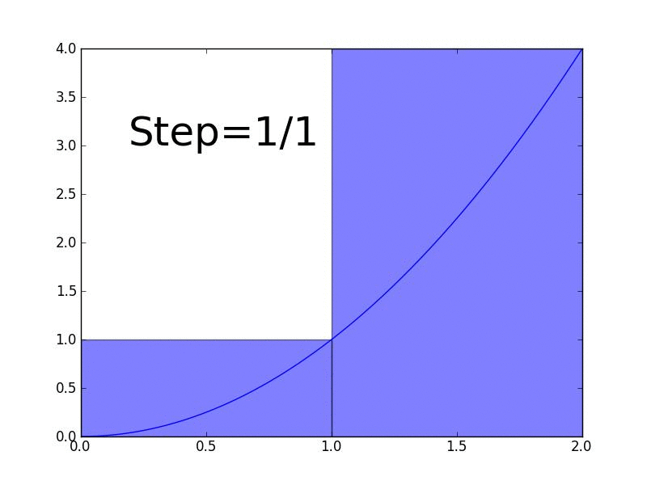
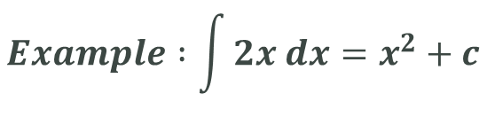

What Is Integration
Integration is a fundamental concept in calculus that involves finding the accumulation or total of a quantity. It is the reverse process of differentiation.

Slide 3

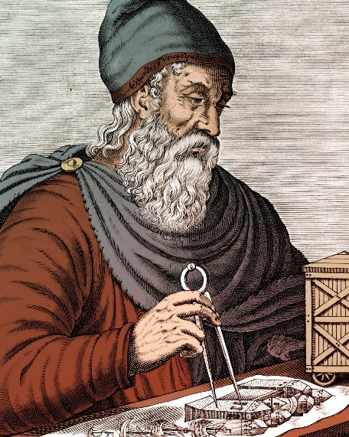
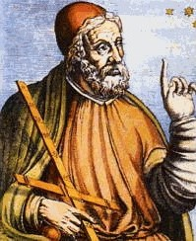
The History Of Integration
Ancient Times
The method of exhaustion, attributed to ancient Greek mathematicians such as Eudoxus and Archimedes, laid the groundwork for integral calculus. This method involved approximating the area of a region by inscribing or circumscribing it with geometric shapes and taking the limit as the number of shapes increased.
Eudoxus
Archimedes

Slide 4
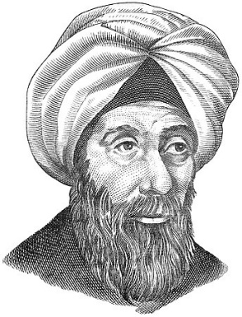
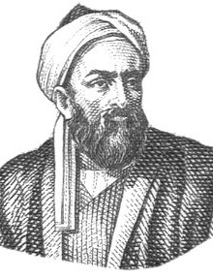

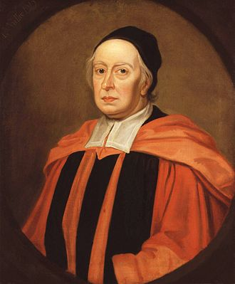
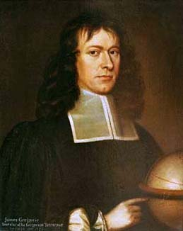
Islamic Golden Age
Mathematicians like Alhazen and Al-Biruni, further developed the method of exhaustion. They applied these principles to problems in geometry and astronomy.
Alhazen
Al-Biruni
17th Century
Mathematicians like John Wallis, James Gregory, and Isaac Barrow made significant contributions, but it was Isaac Newton and Gottfried Wilhelm Leibniz who independently and almost simultaneously developed the fundamental principles of calculus.
Isaac Barrow
John Wallis
James Gregory

Slide 5

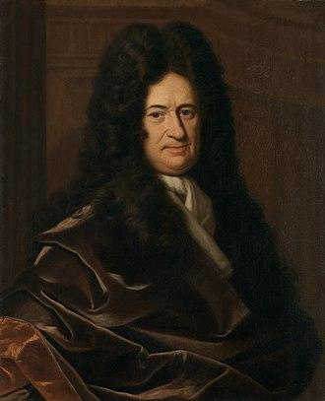
Newton and the Method of Fluxions
Isaac Newton introduced the method of fluxions, a precursor to the calculus of today. Newton's work focused on the concept of instantaneous rates of change, and his notation for integration resembled an elongated 'S.'
Isaac Newton
Leibniz and the Integral Sign
Leibniz introduced the integral sign (∫), which is still used today. Leibniz's notation and approach were more systematic and elegant, and he developed the fundamental theorem of calculus.
Gottfried Wilhelm Leibniz

Slide 6
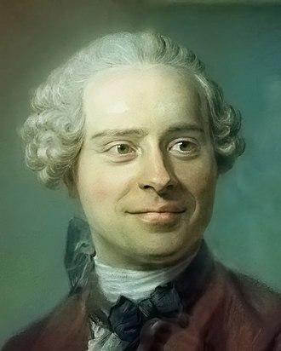

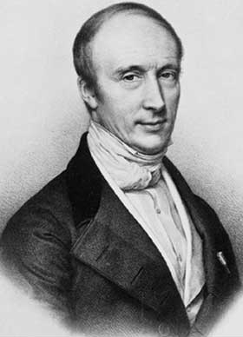
18th Century
Euler, d'Alembert, and others contributed to the understanding and applications of integration.
D'Alembert
Leonhard Euler
19th Century
Cauchy and others provided a more rigorous foundation for calculus.
Augustin-Louis Cauchy

Slide 7
20th Century
Further developments, including the Lebesgue integral and exploration of abstract realms.
Modern Era
Integration has continued to evolve. Mathematicians have explored applications in various fields, and computational methods have facilitated the numerical approximation of integrals.

Slide 8

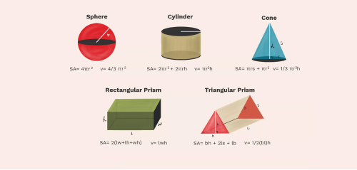
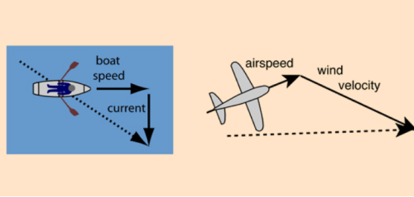

Applications of Integration
Applications in Physics
Area and Volume
Helps us to find area under curves and volume.
Ex – Measuring the volume of a rock.
Motion and Velocity
Helps us to find displacement from velocity.
Ex – Calculating how much distance is traveled.
Work and Energy
Used to calculate how much work is done.
Ex – Lifting weight against gravity.

Slide 9



Applications In Economics and Finance
Revenue and Profit
Applied in calculating revenue and profit functions.
Ex – Measuring the remittance.
Economics and Consumer Surplus
Used to calculate consumer surplus.
Ex – Keep track of supply vs demand.
Finance and Compound Interest
Helps us to calculate compound interest.
Ex – Keep track of banking and investment.

Slide 10



Applications in Engineering
Electrical Engineering - Signal Processing
Used in signal processing.
Ex – Helps to make mini computer.
Mechanical Engineering - Center of Mass
Used to calculate the center of mass.
Ex – Measuring the mass of a bridge before build.
Civil Engineering - Structural Analysis
Helps us to calculate and analyze structures.
Ex – Analyzing the structure of a building in blueprint.

Slide 11

Challenges and Limitations
Complexity
Real-world problems with numerous variables make integration complex as well as modeling dynamic systems can lack closed-form solutions.
Limited Applicability
Integration may not suit all problems. Chaos theory for systems sensitive to initial conditions challenges traditional integration methods.
Assumptions
Simplifying integration with assumptions may not hold true in practice. Dynamic real-world economic factors challenge constant parameter assumptions.

Slide 12

Conclusion
The diverse applications of integration underscore it’s significance across various disciplines, from physics and economics to engineering and biology. While integration serves as a powerful tool for modeling and problem-solving, it is not without challenges. Despite these challenges, the widespread applicability of integration remains undeniable. As we navigate the complexities of real-life problems, integration continues to be a fundamental and evolving aspect of our analytical kit.

Slide 13


